Slide 1
“A Heart
at Ease”
Philippians 4:6-9
Notes:
1

Slide 2
Dis
Dis
Dis
located
advantage
able
Dis
Dis
Dis
appear
believe
own
A lack of ; not having
Notes:
1

Slide 3
Dis
Dis
Dis
located
advantage
able
Dis
Dis
Dis
appear
believe
own
Disease
Disease
Notes:
1

Slide 4
Dis
Dis
Dis
located
advantage
able
Dis
Dis
Dis
appear
believe
own
-
Dis
ease
Notes:
1

Slide 5
Disease: Spinal decay creates a “dis-ease” in the body—a lack of normal “ease” or function.
In a state of dis-ease the opportunity for disease is enhanced.
Obsolete: Lack of ease
Notes:
1

Slide 6
What Causes Dis-Ease?
Anxiety
Prov. 12:25
An anxious heart weighs a man down.
Notes:
1

Slide 7
What Causes Dis-Ease?
Anxiety
Phil. 4:6-9
Do not be anxious about anything, but in everything by prayer and petition, with thanksgiving, present your requests to God. And the peace of God, which transcends all understanding, will guard your hearts and your minds in Christ Jesus.
Notes:
1

Slide 8
What Causes Dis-Ease?
Anxiety
Phil. 4:6-9
Finally, brothers, whatever is true, whatever is noble, whatever is right, whatever is pure, whatever is lovely, whatever is admirable
—if anything is excellent or praiseworthy
—think about such things.
Notes:
1

Slide 9
What Causes Dis-Ease?
Anxiety
Phil. 4:6-9
Whatever you have learned or received or heard from me, or seen in me
—put it into practice.
And the God of peace will be with you.
Notes:
1

Slide 10
What Causes Dis-Ease?
• Jealousy
• Envy
• Anger
• Resentment
• Holding a grudge
• Discouragement
• Conviction
Notes:
1

Slide 11
God wants our hearts
to be at ease!
Notes:
1

Slide 12
Find Rest in God
Cast all your anxiety [care] on him because he cares for you.
1 Peter 5:7 niv
Notes:
1

Slide 13
Find Rest in God
Come to me, all you who are weary and burdened, and I will give you rest….you will find rest for your souls.
Matthew 11:28 niv
Notes:
1

Slide 14
Find Rest in God
May your unfailing love rest upon us, O Lord, even as we put our hope in you.
Psalm 33:22 niv
Notes:
1

Slide 15
Find Rest in God
Find rest, O my soul, in God alone; my hope comes from him.
He alone is my rock and my salvation; he is my fortress, I will not be shaken.
Psalm 62:1-2, 5-6 niv
Notes:
1

Slide 16
Find Rest in God
If we confess our sins, he is faithful and just and will forgive us our sins and purify us from all unrighteousness.
1 John 1:9 niv
Notes:
1

Slide 17
God wants us to have cheerful hearts!
Notes:
1

Slide 18
Proverbs 15:13
“A happy heart
makes the face cheerful.”
Notes:
1

Slide 19
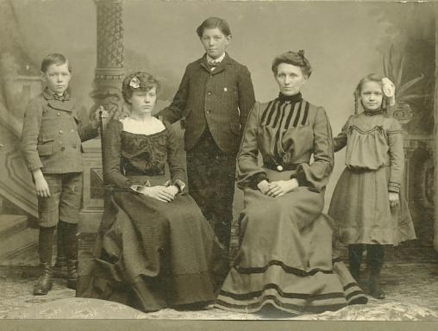
Notes:
1

Slide 20
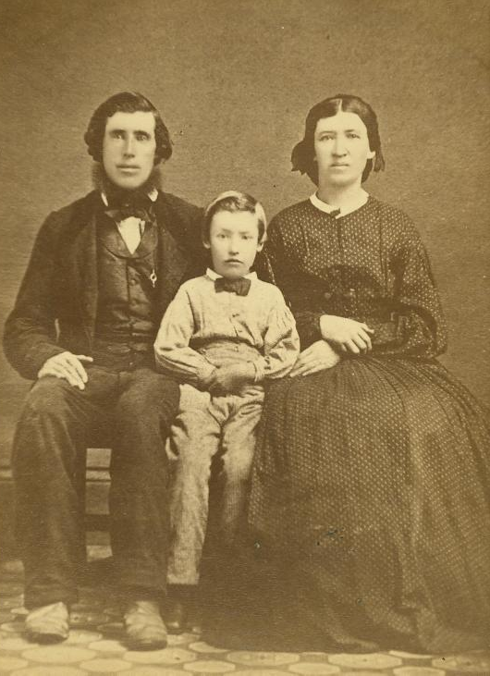
Notes:
1

Slide 21
Proverbs 15:15
“A cheerful heart
is a continual feast.”
Notes:
1

Slide 22
Proverbs 17:22
“A cheerful heart
is good medicine.”
Notes:
1

Slide 23
Proverbs 15:30
“A cheerful look
brings joy to the heart
and good news gives
health to the bones.”
Notes:
1

Slide 24
Proverbs 14:30
“A heart at peace
gives life to the body.”
Notes:
1

Slide 25
Job 29:24
“…the light of my face
was precious to them.”
Notes:
1

Slide 26
Proverbs 3:5-8
“Trust in the Lord will all your heart and lean not on your own understanding; in all your ways acknowledge him, and he will make your paths straight.”
Notes:
1

Slide 27
Proverbs 3:5-8
“Do not be wise in your own eyes; fear the Lord and shun evil. This will being health to your body and nourishment to your bones.”
Notes:
1

Slide 28
Proverbs 16:24
“Pleasant words
are a honeycomb,
sweet to the soul and healing to the bones.”
Notes:
1

Slide 29
Proverbs 27:19
“As water reflects a face,
so a man’s heart
reflects the man.”
Notes:
1

Slide 30
“Whoever listens to me will live in safety and be at ease, without fear of harm” (Proverbs 1:33)
Notes:
1

Slide 31
“Whoever listens to me will live in safety and be at ease, without fear of harm” (Proverbs 1:33)
Notes:
1

Slide 32
Psalm 145
Great is the Lord and most worthy of praise.”
Notes:
1

Slide 33
Psalm 145
“The Lord is gracious
and compassionate.”
Notes:
1

Slide 34
Psalm 145
“The Lord is good to all.”
Notes:
1

Slide 35
Psalm 145
“The Lord is faithful to all His promises.”
Notes:
1

Slide 36
Psalm 145
“The Lord upholds all those who fall and lifts up all who are bowed down.”
Notes:
1

Slide 37
Psalm 145
“The Lord is righteous in all His ways.”
Notes:
1

Slide 38
Psalm 145
“The Lord is near to all who call on him.”
Notes:
1

Slide 39
Psalm 145
“The Lord watches over all who love him.”
Notes:
1

Slide 40
Psalm 145
“Let every creature
praise his holy name
for ever and ever!”
Notes:
1

